Slide 1
Respondent-driven sampling more efficiently identifies undiagnosed HIV-infected people who inject drugs (PWID) than PWID-targeted community integrated care centers in India
Allison M. McFall¹, Sunil S. Solomon², Aylur K. Srikrishnan³, Santhanam Anand³, Canjeevaram K. Vasudevan³, Gregory M. Lucas², Shruti. H. Mehta¹
¹Johns Hopkins Bloomberg School of Public Health, Baltimore, MD; ²Johns Hopkins University School of Medicine, Baltimore, MD; ³YR Gaitonde Centre for AIDS Research and Education, Chennai, India

Slide 2
No conflicts of interest to disclose.

Slide 3
Background
Injection drug use drives HIV in many settings
People who inject drugs (PWID) not adequately engaged in HIV services
  Little HIV knowledge, perceived low risk, stigma, criminalization, difficulty accessing services, ongoing substance use
Resulting in low awareness among HIV-infected PWID

Slide 4
HIV Care Continuum among PWID in India
Mehta SH et al. HIV Care Continuum Among Men Who Have Sex With Men and Persons Who Inject Drugs in India:
Barriers to Successful Engagement. Clinical Infectious Diseases. 2015

Slide 5
Study Design
Data from National Collaboration on AIDS (NCA) trial
  Cluster randomized trial in 26 cities, stratified by population (MSM/PWID)
  To evaluate effectiveness of integrated care centers (ICCs) on uptake of HIV testing
Analyses restricted to PWID stratum and 6 intervention (ICC) cities

Slide 6
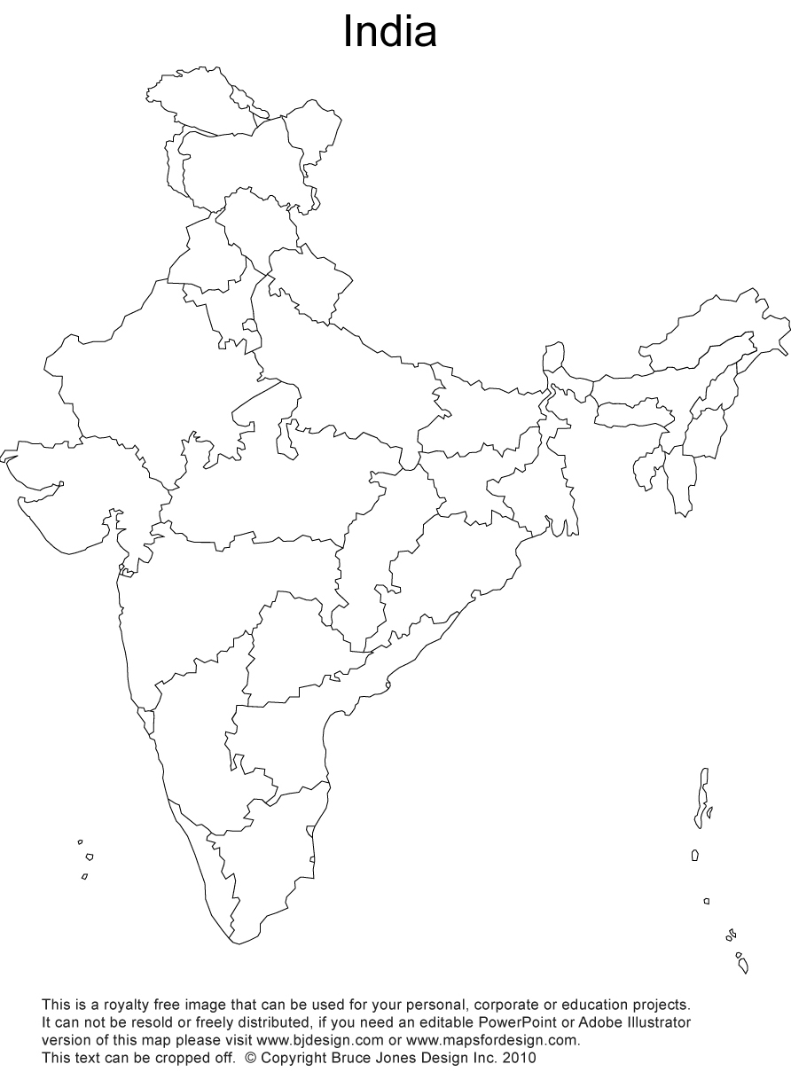
NCA Trial PWID Intervention (ICC)
Study Sites
Ludhiana
Chandigarh
Dimapur
Imphal
Aizawl
Bilaspur

Slide 7
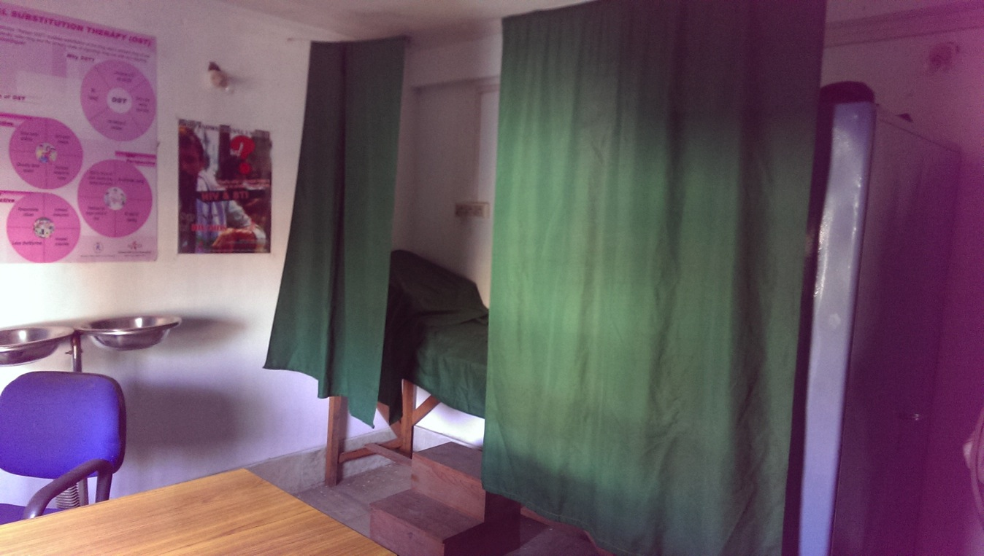
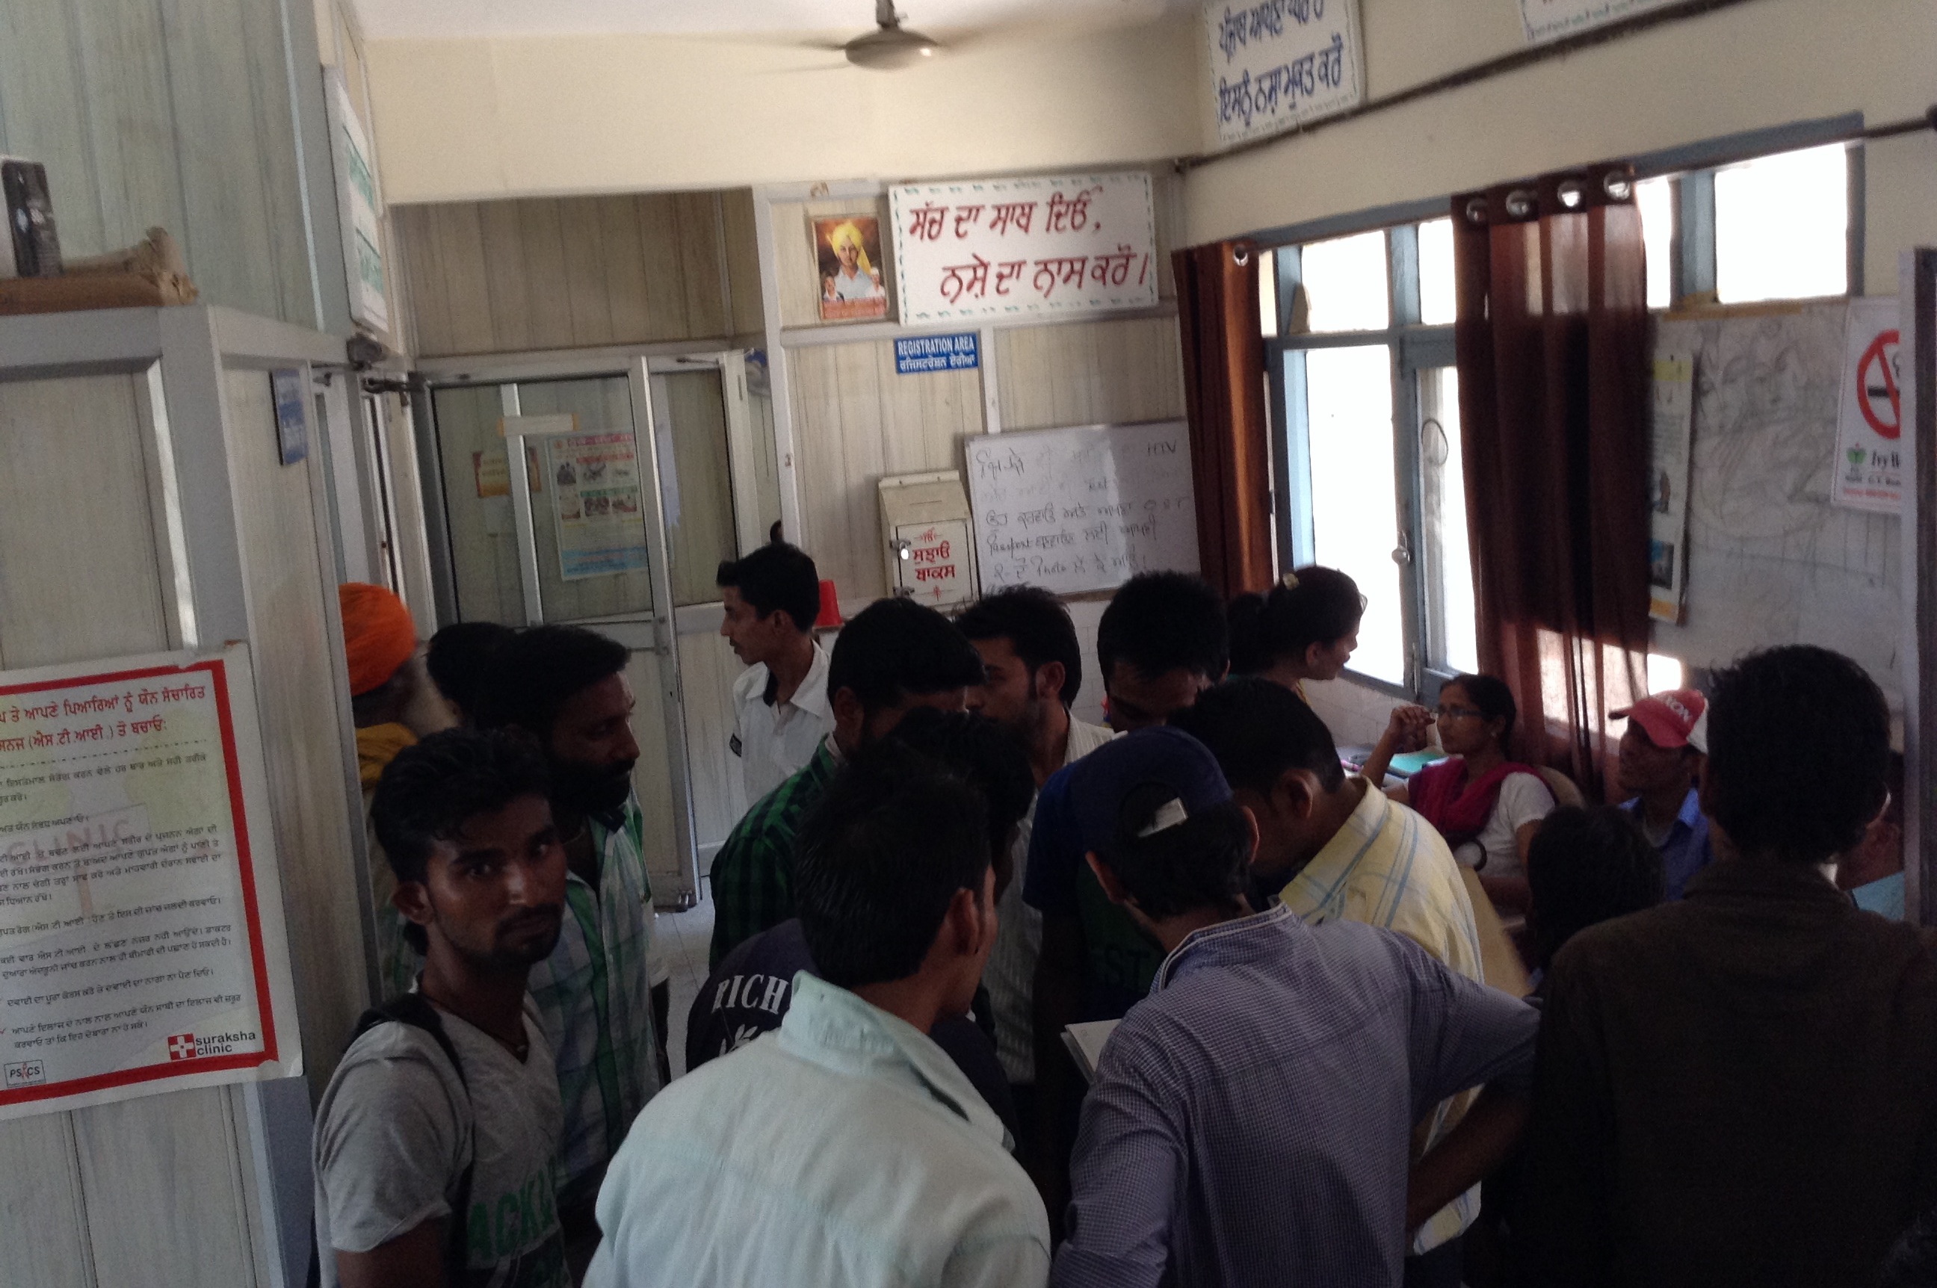
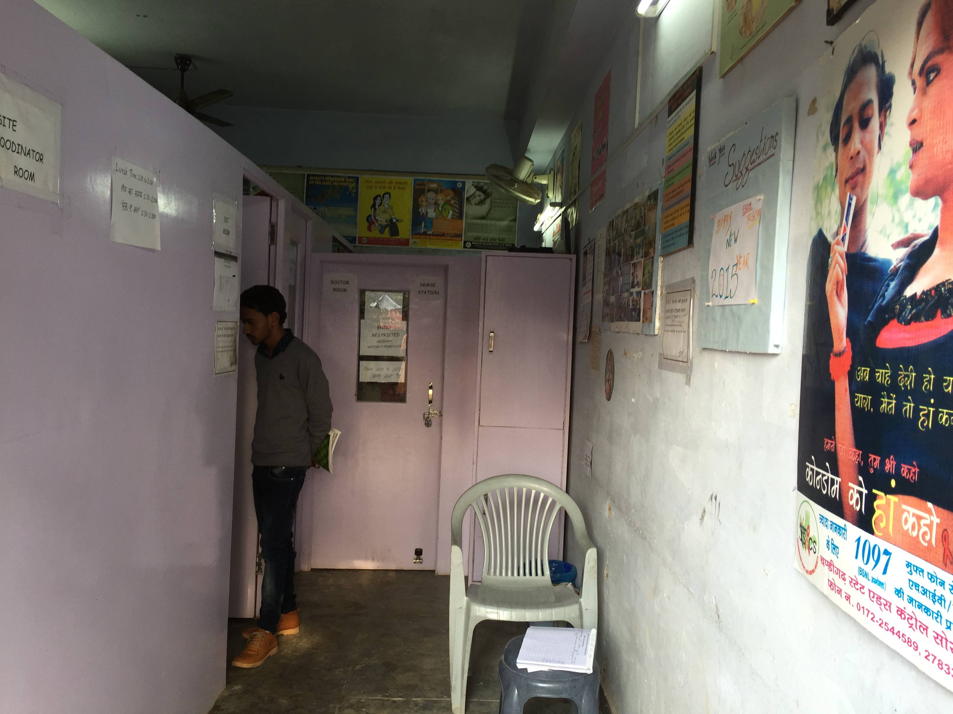
NCA Trial Study Design
ICCs provided PWID-tailored services, 2014-2017
  HIV counseling/testing, needle exchange, opioid agonist therapy, STI screening/tx, referrals, etc.
  Nurse, doctor, counselor on-site
  Peer outreach workers
  Biometrics tracks unique clients, services used, lab
Ludhiana
Imphal
Chandigarh
Notes:
Voluntary use of ICC

Slide 8
NCA Trial Study Design
Evaluation data collection using respondent-driven sampling (RDS), 2016-2017

Slide 9
Respondent-Driven Sampling (RDS)
Sampling method to reach ‘hidden’ or difficult-to-reach populations
Utilizes peer network connections
Widely used in HIV research among key populations (MSM, FSW, PWID)

Slide 10
NCA Trial Study Design
Evaluation data collection using RDS, 2016-2017
  2 seeds (i.e. PWID well-connected in community) initiated recruitment
  Seeds and subsequent study participants received 2 recruitment coupons to give to other PWID
  Compensation for participation (US$4) and referrals ($1 each)
  Total 1000 PWID recruited/city

Slide 11
NCA Trial Study Design
Eligibility criteria for RDS
  18 years or older
  Self-reported injection drug use in prior 24 months
  Informed consent
  Valid RDS coupon (except seeds)
Study procedures
  Interviewer-administered survey - demographics, risk behaviors, HIV testing and care history, depression, etc.
  Onsite rapid HIV testing and counseling
  Biometrics (fingerprint) tracked duplicate enrollments and identified participants that were ICC clients

Slide 12

NCA Trial Study Design
2014
2015
2016
2017
ICCs
Evaluation RDS

Slide 13
Objective
To assess the ability of RDS to identify undiagnosed HIV-infected PWID compared to a venue-based strategy (i.e., integrated care centers) in India

Slide 14
Statistical Methods
Efficiency of RDS vs. ICCs to reach undiagnosed HIV-infected PWID
  Number needed to recruit (NNR) - number screened in order to find one undiagnosed person
  Identification rate - number undiagnosed identified per week
Undiagnosed PWID - tested positive and denied a prior diagnosis
Characteristics associated with identification by RDS only and RDS & ICC, both in comparison to ICC only
  Multinomial logistic regression

Slide 15
Results
Total N=14,397
RDS participants
ICC clients
N=8385
N=2374
N=3638

Slide 16
Correlates of identification by RDS only vs. ICC only
Characteristic | RDS only Adjusted OR¹ | 95% CI
Age (by 10 yrs) | 1.03 | 0.98 - 1.09
Male (vs. female) | 6.47 | 5.33 - 7.86
Marital Status
Married | Reference
Never married | 1.16 | 1.07 - 1.26
Widow/divorce/sep | 1.77 | 1.52 - 2.07
Education
Primary or less | Reference
Secondary | 0.67 | 0.61 - 0.75
High school and above | 1.76 | 1.55 - 2.00
Undiagnosed HIV+ | 2.50 | 2.11 - 2.95
Adjusted for site and all other covariates shown in table; OR: Odds Ratio; CI: confidence interval

Slide 17
Correlates of identification by both ICC and RDS vs. ICC only
Characteristic | RDS only Adjusted OR¹ | 95% CI | ICC & RDS Adjusted OR¹ | 95 % CI
Age (by 10 yrs) | 1.03 | 0.98 - 1.09 | 1.06 | 1.00 - 1.13
Male (vs. female) | 6.47 | 5.33 - 7.86 | 2.70 | 2.20 - 3.31
Marital Status
Married | Reference |  | Reference
Never married | 1.16 | 1.07 - 1.26 | 1.10 | 1.00 - 1.21
Widow/divorce/sep | 1.77 | 1.52 - 2.07 | 1.11 | 0.90 - 1.39
Education
Primary or less | Reference |  | Reference
Secondary | 0.67 | 0.61 - 0.75 | 1.01 | 0.89 - 1.14
High school and above | 1.76 | 1.55 - 2.00 | 0.95 | 0.80 - 1.13
Undiagnosed HIV+ | 2.50 | 2.11 - 2.95 | 1.54 | 1.23 - 1.92
Adjusted for site and all other covariates shown in table; OR: Odds Ratio; CI: confidence interval

Slide 18
Number needed to recruit (NNR) for undiagnosed HIV-infected PWID, by city and strategy
ICC: integrated care center; RDS: respondent-driven sampling
Y-axis is ln transformed

Slide 19
Identification rate per week for undiagnosed HIV-infected PWID, by city and strategy
ICC: integrated care center; RDS: respondent-driven sampling
Y-axis is ln transformed

Slide 20
Limitations
Self-reported awareness of HIV-infection status
Two approaches (RDS and ICCs) not concurrent
  Migration and other temporal changes
Unable to separate out effect of network-driven strategy and monetary compensation within RDS on efficiency

Slide 21
Conclusions
Compared to a venue-based strategy (i.e. ICCs), RDS required screening fewer PWID and more rapidly identified undiagnosed HIV-infected PWID
Network driven strategies with compensation could be used to identify and engage groups not visiting venues

Slide 22
Acknowledgements
Co-authors
Sunil S. Solomon
Aylur K. Srikrishnan
Santhanam Anand
Canjeevaram K. Vasudevan
Gregory M. Lucas
Shruti. H. Mehta
NCA study staff and participants
Funding
NIH: F31DA044046, R01DA032059, R01MH8966, T32AI102623, P30AI094189
Elton John AIDS Foundation
NACO

Slide 23
Questions?
Contact information:
Allison M. McFall, MHS
amcfall2@jhu.edu

